Slide 1
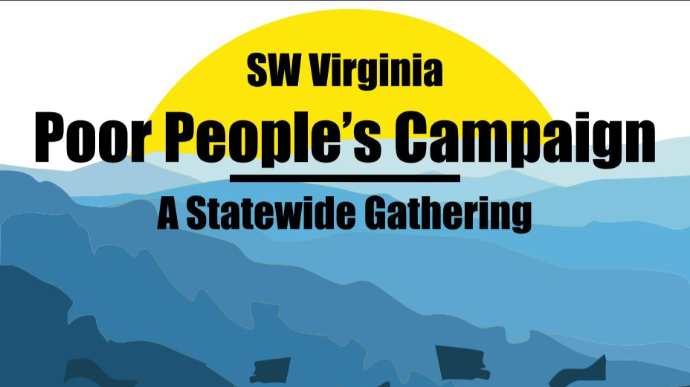

Slide 2
5 Actions You Can Take in Virginia
7 Protections Against Fracking published every Thursday
facebook.com/waterislifeprotectit/
TAKE THIS JOB AND STOP IT! Demand that all work on the Mountain Valley and Atlantic Coast Pipelines stop during the pandemic. They were never “essential”. Now bringing out of state crews into our rural communities while all monitoring (such as it was) is shut down is murderous.

Slide 3
5 Actions You Can Take in Virginia
Petition Legislators and educate public on injustice of tolling orders in FERC’s Pipeline Approval Process
Protect Your Vote: Request your absentee ballot for the June 23rd election using the COVID-19 excuse
Petition VA Legislators for Vote By Mail

Slide 4
5 Actions You Can Take in Virginia
SAVE RASSAWEK
Need public comments to army corps by May 7: Save Rassawek: This is not a fossil fuel issue, but it is an environmental justice issue and the recent decision to desecrate the sacred Monacan capital of Rassawek must not stand. Support this protection. Prevent this wrong.
Donate: https://gofundme.com/f/save-rassawek or send support to:
Monacan Indian National Cultural Foundation, PO Box 1136, Madison Heights, VA 24572 (tax-deductible donation)
Learn: http://www.culturalheritagepartners.com/saverassawek

Slide 5
5 Actions You Can Take in Virginia
Sun Sing in Place Concert: Thursday, May 7: 7-8 pm Join the third bi-weekly ARTivism Virginia Concert.
Virginia environmental resistance music, poetry, guest speaker updates, video and action alerts. Live on Facebook: www.facebook.com/artivismvirginia/
Vimeo: www.vimeo.com/artivismvirginia/
and YouTube:www.youtube.com/c/artivismvirginia/
Event link: https://www.facebook.com/events/211320560098944
This one focuses on Bent Mountain/MVP and GND VA. Bent Mountain Video debut: Fire on the Mountain
Plan is to feature Environmental Justice and PPC at the final concert on June 18.

Slide 6


Our Virginia Vote in 2020
Election Information: Ballotpedia
Voter Data: NGPVAN

Slide 7
Virginia 2020
9.1 million age eligible voters
5.4 million Voters
2.8 million unregistered/dropped

Slide 8
Unregistered Voters of Color
County/City | African American | Hispanic | Asian | Total
Alexandria | 8,486 | 3,791 | 2,198 | 14,475
Fairfax | 22,249 | 26,910 | 41,822 | 90,981
Newport News | 24,259 | 3,236 | 1,039 | 28,534
Norfolk | 31,606 | 4,239 | 1,560 | 37,405
Richmond | 30,980 | 1,668 | 1,081 | 33,729
Roanoke | 8,401 | 1,030 | 303 | 9,734
Virginia Beach | 21,165 | 7,981 | 5,822 | 34,968
 | 147,146 | 48,855 | 53,825 | 249,826

Slide 9
What We Will Do
Make Phone Calls
Send Text Messages
Send Postcards

Slide 10
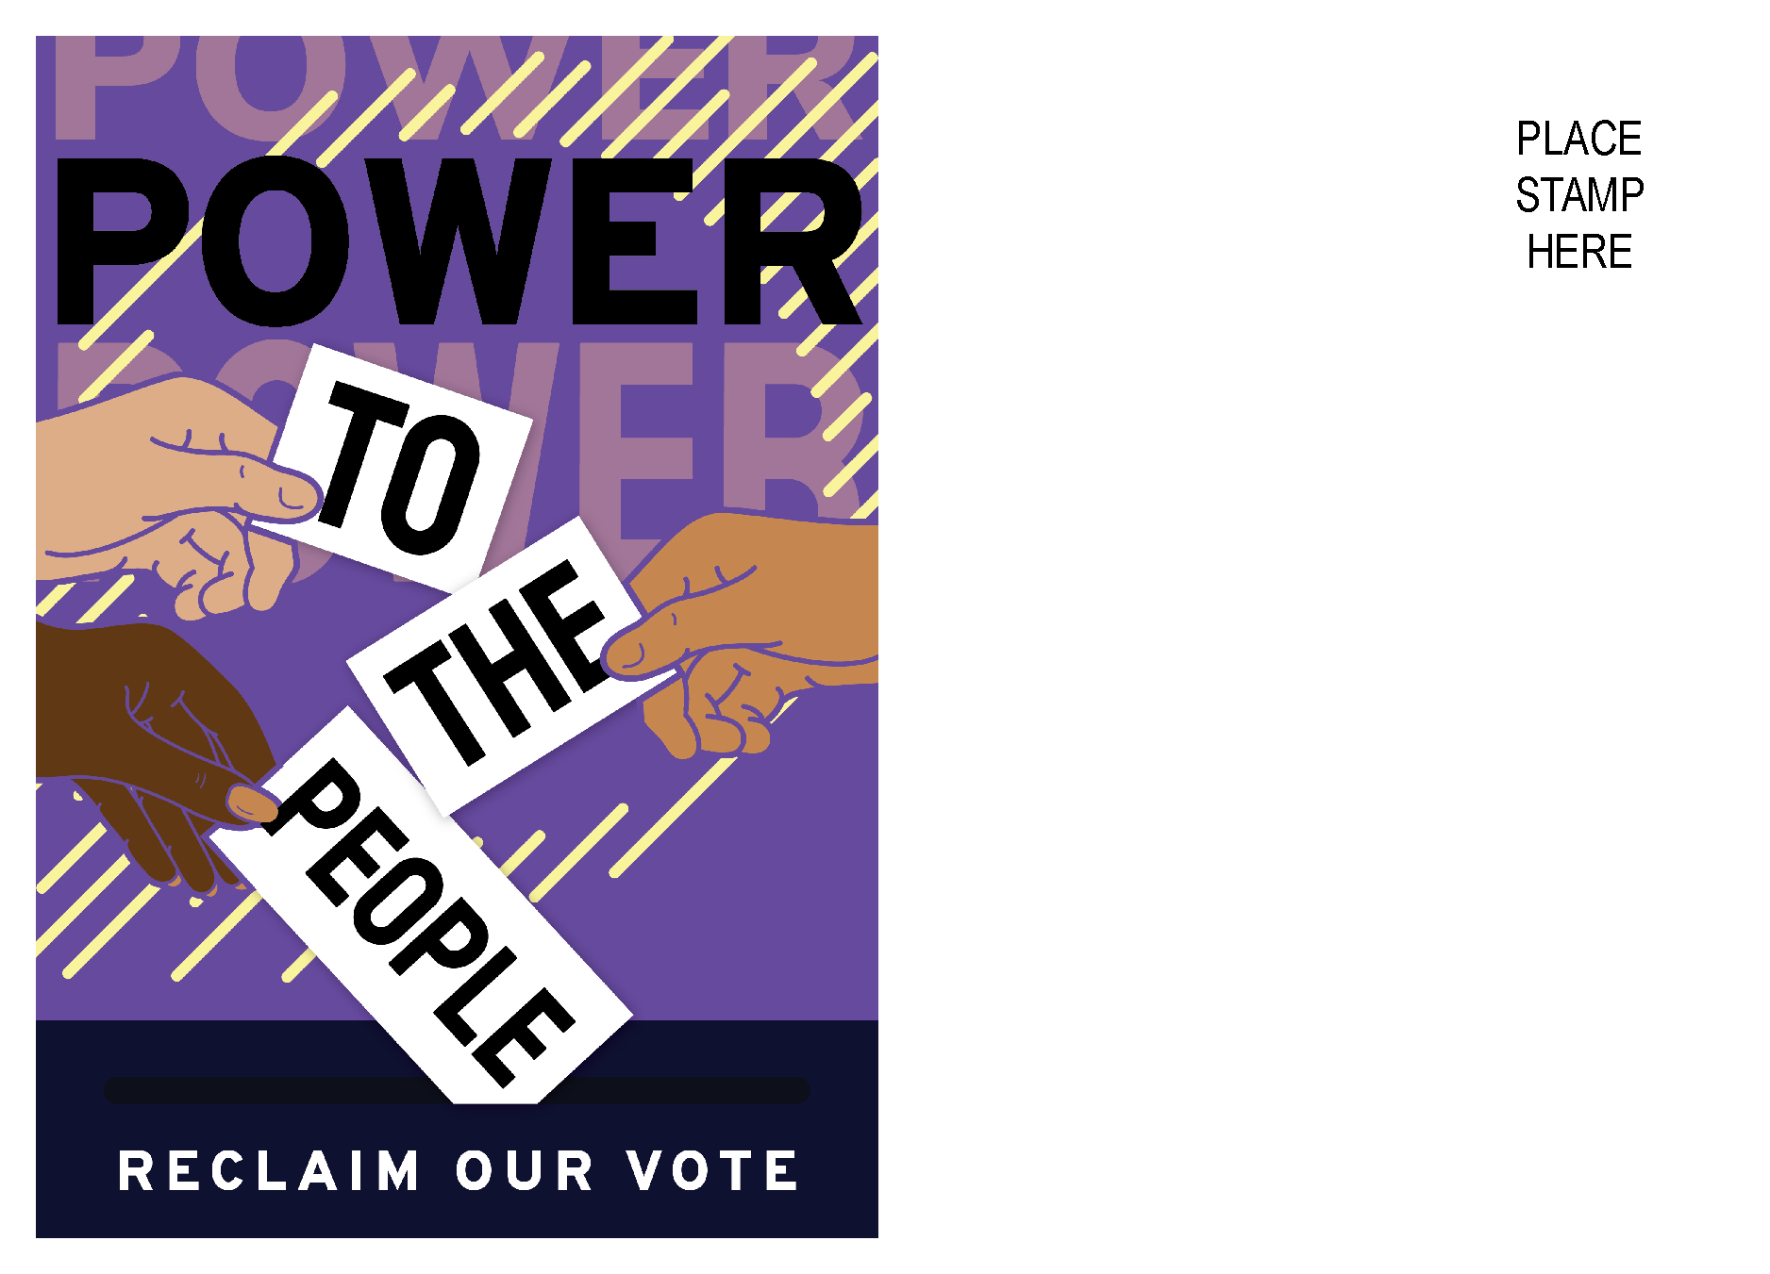
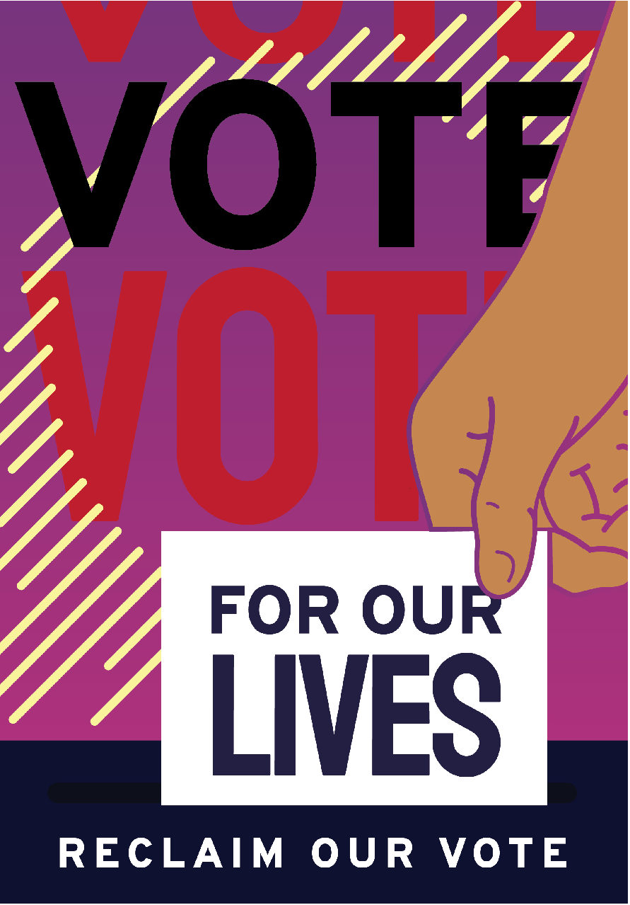
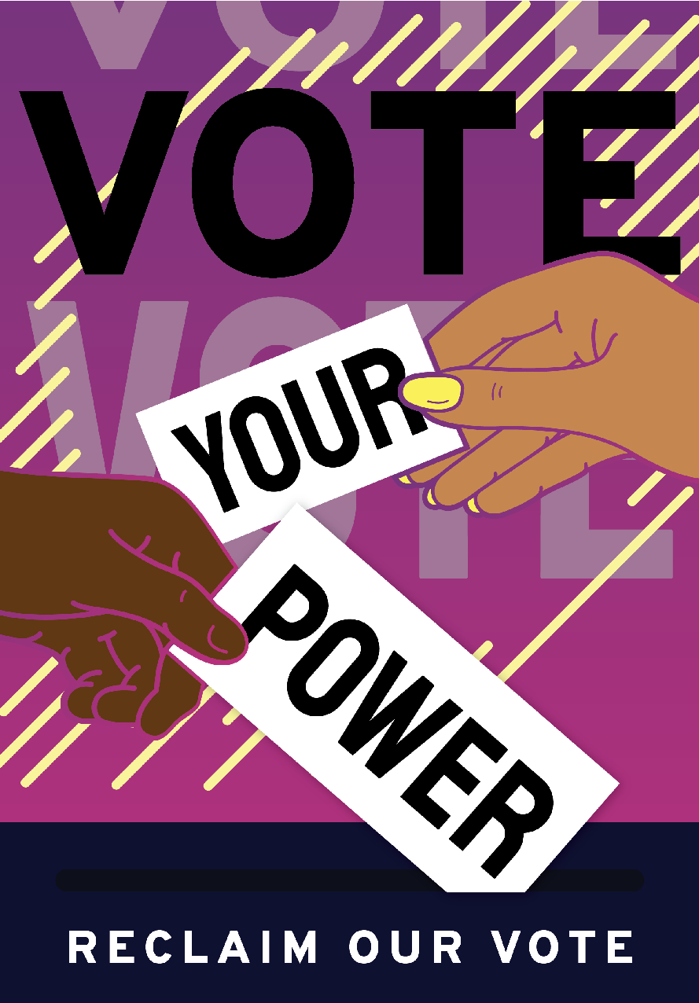
Postcard Designs

Slide 11
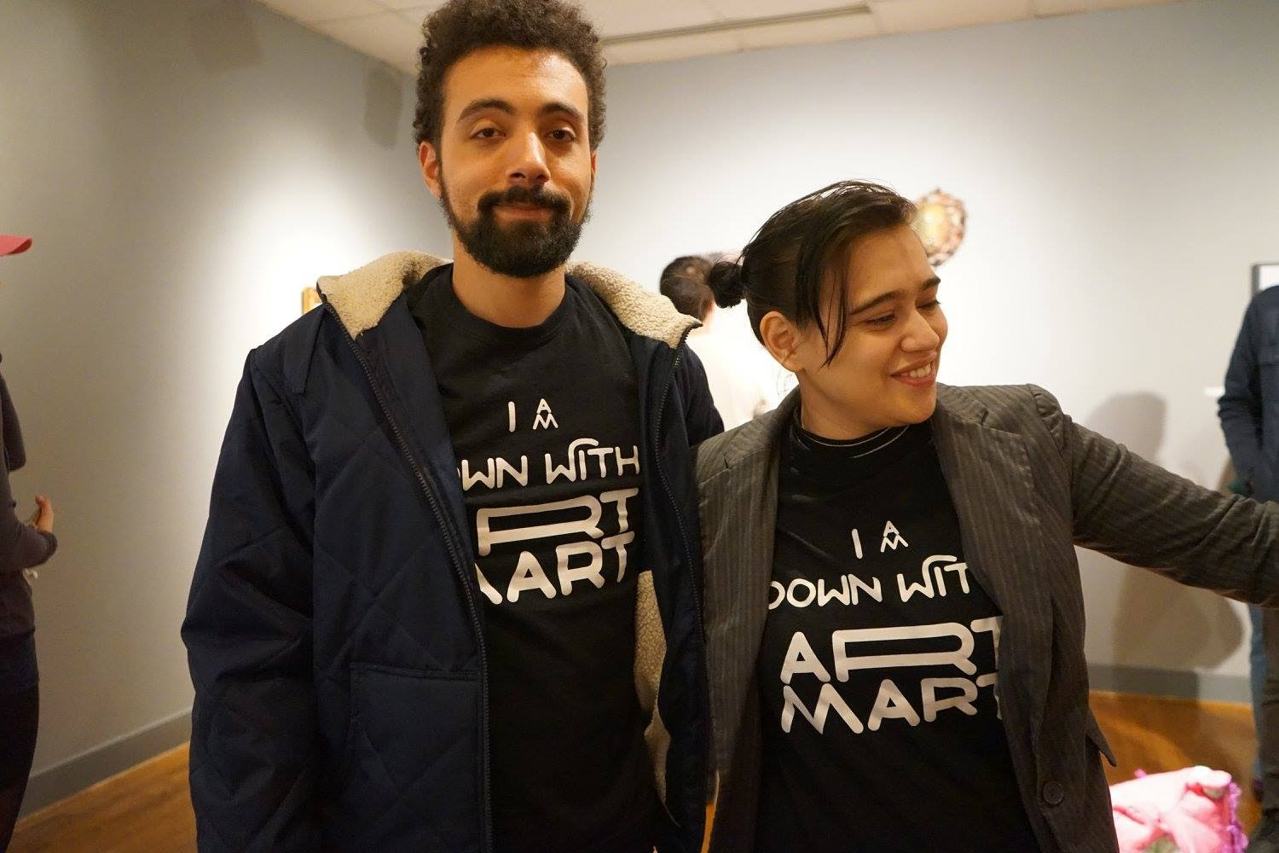
ROV Postcard Designers
Saint Solari’s Leonina Arismendi Zarkovic and Justin Andrew Young are a creative team of graphic and web designers with over ten years of art and design experience and working together.
Leonina is a professional, international artist and muralist originally from Montevideo, Uruguay.
Justin A. Young was voted 30 under 30 by Washington Life Magazine as one of the most influential artists and creative producers in DC during the Obama Era.

Slide 12
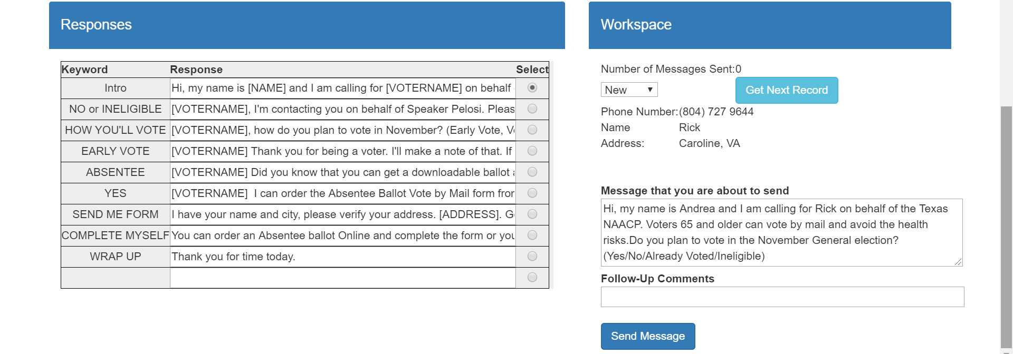
Text for Less – New Text

Slide 13
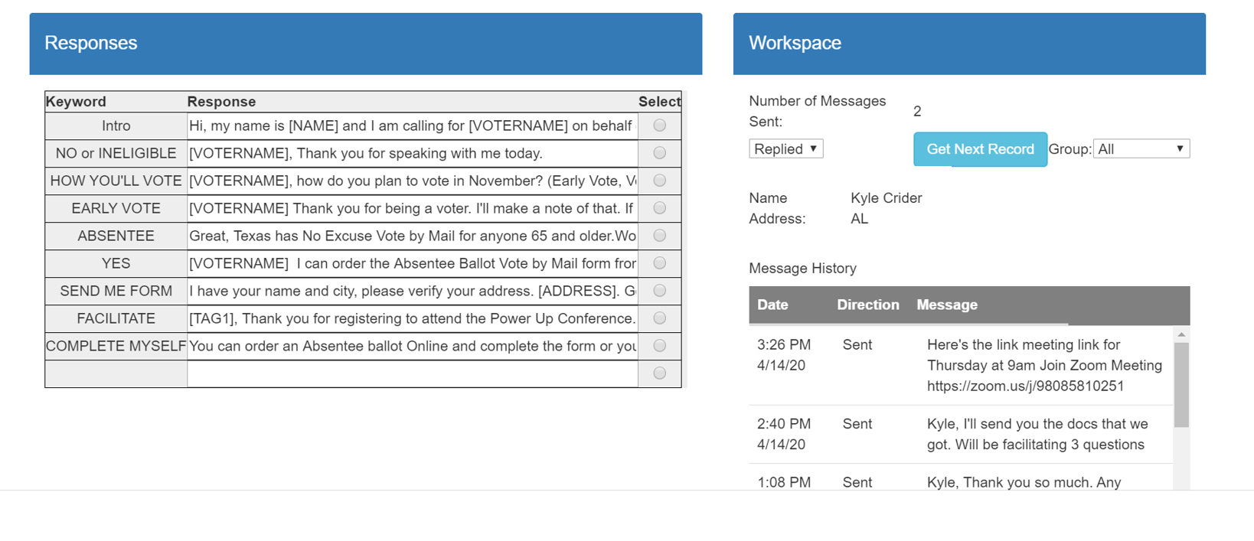
Text for Less - Response

Slide 14
Virginia Elections
State | News
Primary Election | Primary Rescheduled to June 23rd
Absentee/Vote by Mail https://www.elections.virginia.gov/casting-a-ballot/absentee-voting/index.html | For the primary an excuse is required; COVID-19 is acceptable Absentee request excuse Deadline to request ballot is June 16th Deadline to request ballot is October 27th
Voter Registration Primary | Check your voter registration at tinyurl.com/vappc Deadline is May 26th
Voter Registration General | Deadline is October 27th
General Election | November 3rd

Slide 15
Vote by Mail
State | Vote by Mail Rules
Virginia | The Virginia Department of Elections encourages voters to protect their health during COVID-19 outbreak. Voting absentee in the coming May and June elections is strongly encouraged. Voters may choose reason "2A My disability or illness" for absentee voting in the May and June 2020 elections due to COVID-19. Voters who choose the absentee option should do so as soon as possible so they can get their ballots in time to return them by mail by Election Day. Download and Print Voter Forms Here https://www.elections.virginia.gov/registration/voter-forms/ Request Absentee Ballot Online/Must have VA DMV or DMV ID tinyurl.com/vappc

Slide 16
Virginia Poor People’s Campaign
SW Virginia
  Rev. David Denham – revdavid@poorpeoplescampaign-va.org
Central Virginia
  Andrea Miller – andrea@poorpeoplescampaign-va.org
Hampton Roads
  Steve Hansen – steve@poorpeoplescampaign-va.org
NOVA
  Gerson Sher – gerson@poorpeoplescampaign-va.org

Slide 17
Virginia Poor People’s Campaign
Shenandoah
  Adrienne & AJ – a-and-a@poorpeoplescampaign-va.org
Lynchburg
  Finny Matthew – finny@poorpeoplescampaign-va.org
Harrisonburg
  Bruce Lundeen – bruce@poorpeoplescampaign-va.org

Slide 18
Visit Us on the Web
http://www.poorpeoplescampaign-va.org
https://www.facebook.com/VAMoralRevival/
http://www.poorpeoplescampaign.org

